Slide 1

Think Like a Certification Exam
Redmond SQL UG – July 12 2023
William Assaf, Microsoft
Notes:
<introduction>
Content is not specific to Microsoft technologies and exams, though that is where my experience lies as a consultant, as a certified pro, and as an exam item writer, and now an employee of Microsoft.

Slide 2
Pop Quiz
You are a member of the Council of Elrond.
You must choose someone present to bring the One Ring to Mordor. One does not simply walk into Mordor. The ring-bearer must not be desirous to use the ring to help their own kingdom. The ring-bearer must not own another of the Rings of Power.
You need to choose a ring-bearer.
Who should you choose?
A. Smeagol
B. Boromir of Gondor
C. Frodo Baggins
D. Gandalf the Grey
Notes:
Pop Quiz!
<read slide>
<click>

Slide 3

Agenda
Why take a cert exam?
Benefits, studies
Who are exams for?
Career paths and role-based exams
How to prepare for exams
New Learn resources for exams
What exams try to test
SME process
How exams are written
Writing distractors
Deconstructing wrong answers
Deconstruct fun sample questions
As time allows

Slide 4
Certified Technology Professionals
Certified employees are 17% more productive.
Certified reduce unplanned downtime by 56%.
Certified employees are generally more satisfied with their jobs and enjoy tenures that are 15% longer than uncertified.
60% of employers use certs to confirm expertise.
Certified IT Pros get promoted 50% faster than non-certified.
70% of newly-certified IT Pros achieved their exam goal: new job, higher pay, or promotion.
Microsoft Learning White Paper http://download.microsoft.com/download/9/4/B/94B5442E-0494-4B42-A5DC-8742E4254B09/BVW-Microsoft-US40548315.pdf
CompTIA HR Perception of IT Training and Certification Study: 2015 https://certification.comptia.org/docs/default-source/downloadablefiles/hr-perceptions-of-it-training-and-certification.pdf
MICROSOFT CERTIFICATIONS DATA SHEET Ten reasons to earn a Microsoft Certification https://query.prod.cms.rt.microsoft.com/cms/api/am/binary/RE4FRd2
2021 Value of IT Certification Report: https://home.pearsonvue.com/voc/2021-report
Notes:
<read notes instead>
Here are some statistics from both Microsoft and CompTIA talking about employees who are certified being more productive, responding better, having better careers, being respected by employers. Does a certification make you a better database administrator per se? No, I’m not implying causation here, but the process of preparing for an exam, the preparation of the materials, and the mindset that led you to the self-improvement path of the certification exams, those are all productive, causative, and beneficial for your career. So good for you for attending this session today and probably feeling the need to get certified.
According to a 2021 study, 70% of folks who got certified achieved the goal they had for pursuing the certification, whether it was a new job, a raise, or a promotion.
A final note I’d say is that becoming certified makes your skillset broader, more aware of features, and potentially better at choosing the right solutions for the right problems. It also expands

Slide 5
What don’t I know?
What we are aware of
What we know we don’t know
Notes:
Have you ever met someone who is very confidently wrong? It’s likely because they don’t know what they don’t know.
Imagine a circle that represents what we know. The circle contains our knowledge.
<click>
The red circumference of the circle represents the boundary of what we don’t know, and represents we what we are aware of that we don’t know.
<clicko>
As the circle of what we know grows, so does the circumference, representing an increase of what we know that we don’t know. This is a good thing. We want to grow our circle.
<click>
In psychology this is called the Dunning-Krueger effect, which is a personal underestimation of the amount of knowledge we have in an area. It’s an illusion we tell ourselves, about how much there is to know about a subject, and how much we know.
Sometimes, our work responsibilities are narrow. I didn’t use every feature of SQL Server in my 13 years as a SQL Server consultant. How was I to know what I didn’t know?
Certification exams help us broaden our knowledge and grow our circle. There are parts of SQL Server that I know mostly from studying and taking cert exams.
So yes, cert exams help us become aware of new products, new features, stuff we didn’t know we didn’t know.

Slide 6
Who are exams for?
Microsoft exams are designed to test experience, not book knowledge.
Asking a new university grad or entry-level employee to take an advanced cert exam is not something I advise. It leads to one of three outcomes:
They pass the exam. (Least likely)
More likely:
They fail the exam, possibly multiple times, resulting in frustration/disillusionment, even career derailment.
They try to cheat. Outcomes dubious.

Slide 7
Fundamentals exams
900-level exams: for students and newcomers.
All providers have similar fundamentals exams to drive skills adoption in their platforms or technologies.
I highly recommended AZ-900 for everyone.
More advanced exams: for 2+ years of real experience.
Don’t have unrealistic expectations at entry level.
Employers should pay exam fees, even if they fail.
Incentivize taking exams for the right reasons, enable their preparation with resources.
Notes:
If you’re a student or entry level to a field, Learn has eight different 900-level fundamentals exams and for this audience.

Slide 8
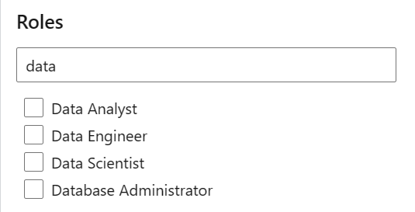
Certifications for SQL DBAs
Exam DP-900: Microsoft Azure Data Fundamentals
Microsoft Certified: Azure Data Fundamentals
Exam DP-300: Administering Microsoft Azure SQL Solutions
Microsoft Certified: Azure Database Administrator Associate
learn.microsoft.com/certifications/browse
Notes:
So, first, What have they done with my MCSD/MCSE/MCSA?
If it starts with 70-, the exam is almost certainly already retired or will be retired by January 2021. That deadline was actually moved back six months because of COVID-19! This includes all exams associated with MCSA MCSD and MCSE, and which expired last summer.
There are only two certs right now for SQL Server administration, here they are. DP-900 is a good exam for Azure data platform products, it actually covers multiple roles, including fundamentals for Database Admins, Data Engineers, and Data Analysts. I’d highly recommend the AZ-900 and DP-900 exams for this crowd.
But that’s not all. There are other certs for other roles.
There are 3 certifications for Data Engineers which include Data Factory and other data platforms like Cosmos and Synapse Analytics.
There are 4 certifications for Data Analysts, including Power BI exam content which you’ll find with exam DP-500 and PL-300.
And there are 3 certifications for Data Scientists including Azure AI.

Slide 9
Modes of Employee trainings
Classroom training lengthy, hit-and-miss.
Travel conferences are expensive, lengthy.
Instead: Self-paced learning, labs resources.
Adult learners typically learn best when actively engaged, not just listening.
Notes:
<read slide>
If you’re in consulting, like I was, then classroom training is a double whammy, you’re losing the billable hours and the cost of the training.
<click, read slide>
Tips on travel conferences:
1. Require knowledge transfer afterwards. It makes the notes the attendee takes a little more detail oriented.
And another Tip: Require proof of hands-on-lab completion when sending employees off, or specific technology goals. Lots of big conferences
<click, read slide>
Those resources should probably include Azure credits for self-paced lab learning.
Employees should also take advantage of the easy free training opportunities to earn expensive paid ones (Hint: This. Event. Right. Now.) So give yourself a pat on the back.

Slide 10
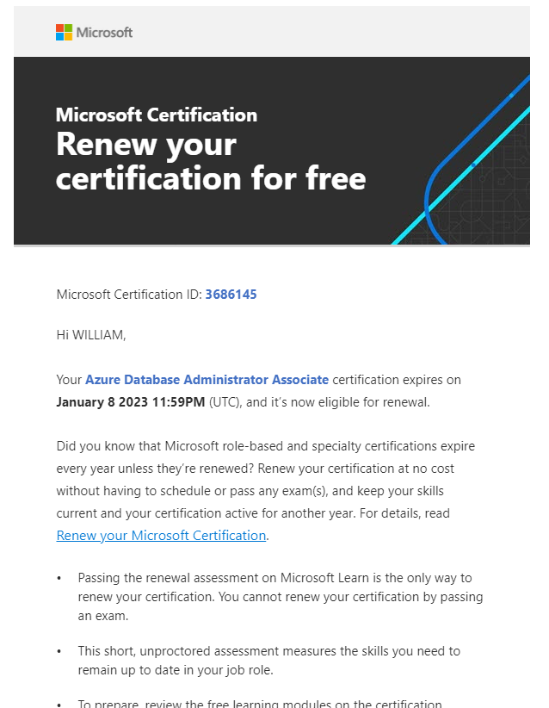
Cert renewal
Some certs renew annually, with nothing but a free online self-paced assessment.
You can take the assessment multiple times to renew.
Notes:
If you need to, you can take the assessment multiple times before the certification expiration date. There’s a 24-hour waiting period after the first attempt, but there’s no waiting period for any subsequent attempts.
I renewed my Azure Database Administrator cert with a short online assessment, free, and on-demand.

Slide 11
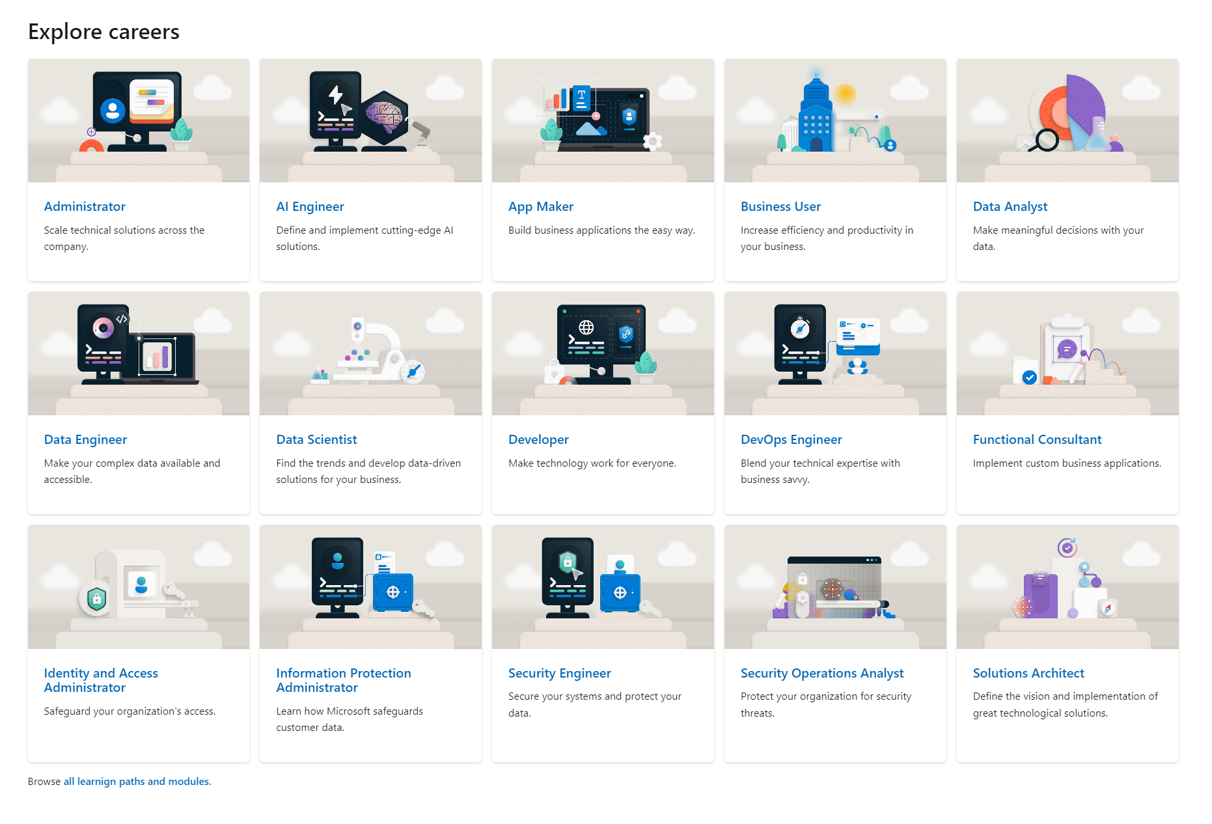
Career Paths
learn.microsoft.com/training/career-paths/
Notes:
Explore Career Paths on Microsoft Learn | Microsoft Learn
Microsoft’s Emphasis is on Solutions has evolved over the last decade, and now we have these role-based certs and exams.
There is no such thing as a one-dimensional certification because there are few cases of one-dimensional jobs.
This is intentional and raises the value of a certification – a certification should mean you have broad experience.
There’s a focus on practicality and actual usage of the products.
These role-based certifications have to do with the job, not with the products. And when you think about it, this makes a lot more sense for your career and your employer. You should have whole solutions experience, not halfway experience.
Microsoft has a new career paths portal to identify your current or goal path and the certifications associated with them. Got students or career switchers in your life? This is a good page to send them.

Slide 12
What’s on a Cert Exam?
Review the domain of the exam.
Each exam comes with a study guide.
Unfamiliar features? Find out more.
Something you’ve never done before? Try!
Then, use the free resources…
Notes:
<read notes>
Review the domain of each exam, this is essentially the study guide that covers what’s on the exam. Anything unfamiliar to you? Now you know where to go and lab it out, where to study.
On each cert exam’s page, there are tons of free resources available to you, and these have expanded recently…

Slide 13
New Microsoft resources
Microsoft’s training content on Azure topics is good, with in-browser free sandboxes.
Actual Azure resources, for free!
Demo the exam experience
Become familiar with interface, question types
29 Microsoft certification exams now have free 50-question practice assessments.
Practice exams started rolling out in Jan 2023
Use practice questions to find weak spots.
Notes:
Many exams are offering in-browser remote connections to azure Azure resources that live for up to four hours for you to get actual hands-on experience, completely for free.
<click>
The demonstration sandbox which mimics the exam look and feeling and lets you see the different types of questions in a website. You’ll see how the interface works for multiple choice, multiple select, drag and drop, build order lists, how exhibits work, and more. Use this demonstration of the questions to increase your familiarity and confidence going into the exam, especially if it is your first time taking a Microsoft certification exam.
<click>
Finally, Microsoft is now providing free practice exams with realistic technical questions. 29 cert exams from Microsoft have free online 50-question practice exams. No more need to sign up for a service or a subscription or something, you have a high quality free practice exam available to you.

Slide 14
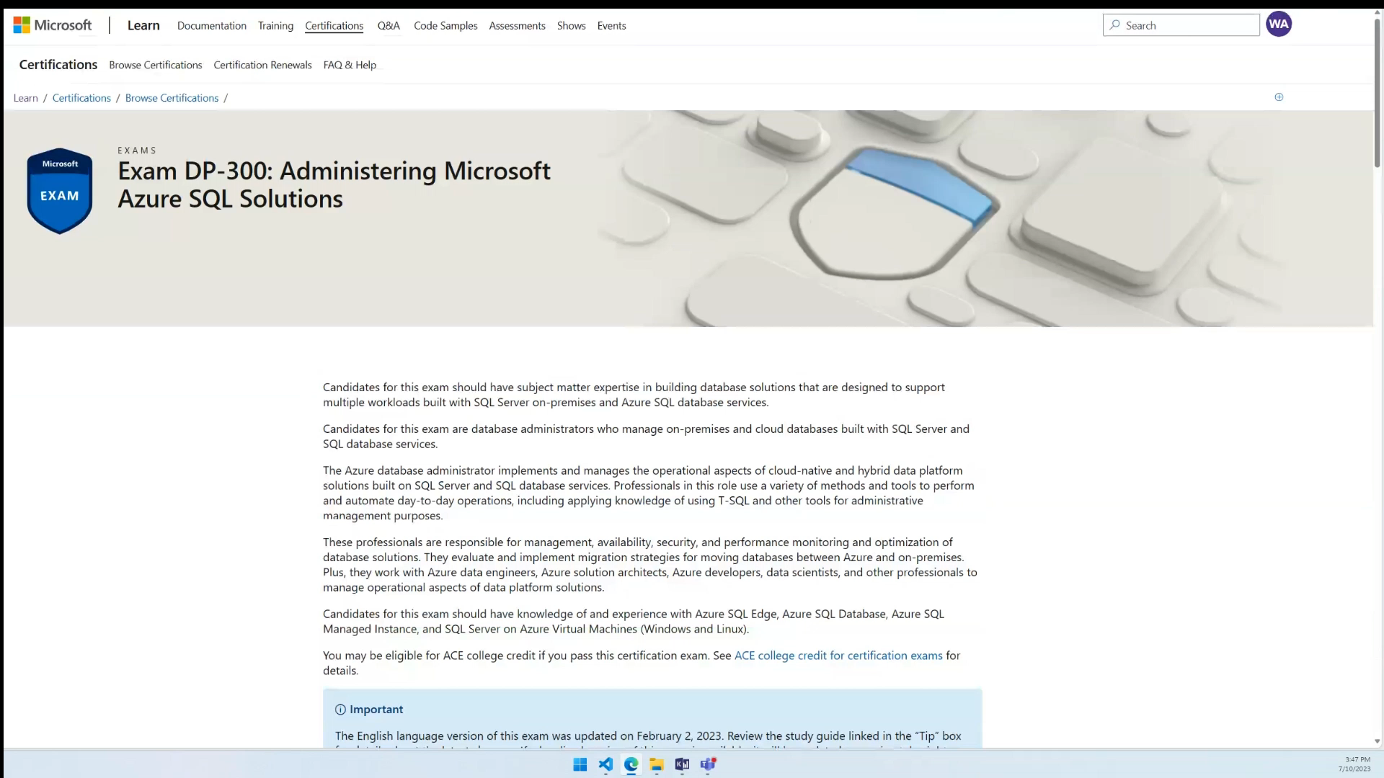
Free practice exams
Notes:
You can find the free online practice exams on each exam’s page, right under the yellow button to Schedule exam, for example, on DP300. No risk, no waste of time, no excuses not to find weak spots in your knowledge before taking an exam.

Slide 15
Study by doing
Lab environment at home or work, so you can build, break/fix, and learn.
Don’t have a test lab? Try to build one, it’s educational.
Invest time in your career.
Have a lab environment installed on your work/home PCs, or use Azure. (Free credits for students, new accounts, from work, etc.)
Use Learn sandboxes or other free labs.
Notes:
So use the free training materials obviously, but how do you learn this stuff? Study by doing.
<read slide>

Slide 16
How To Prepare for Cert Exams
Do not study only by reading books/online.
Memorization is rarely tested.
Though, you must know the subject material,
proper feature choice is likely to be tested.
For example, code sample questions are likely to test dependency or correct tactic, not syntax.
AZ-900 is a great fundamentals intro exam for everyone, good test-taking experience!
Notes:
<read slide then notes, on last bullet:>
To build confidence and have a good test-taking experience, one exam I highly recommend is AZ-900, the page of Azure Fundamentals exam. Highly recommend it by the way, for every professional, every consultant, every manager who works with Azure. There are hours of free interactive training with review quizzes on the website.

Slide 17
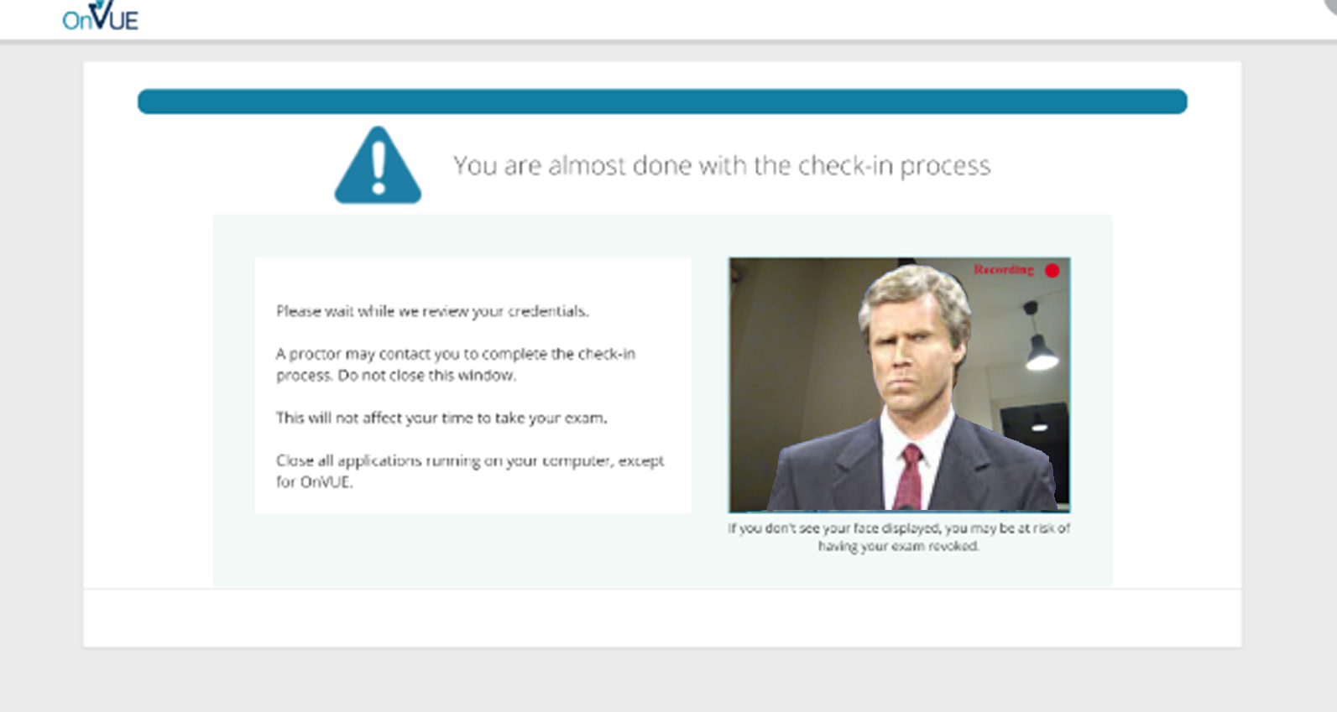
Cert exams? In this economy?
Online Proctored Exams:
Notes:
You’re wondering, with a pandemic, and hurricanes, and inflation, and between all my hiding under the safety of the covers, how do I take a Microsoft Certification Exam? What testing center is even open this week?
If you reknot aware, Pearson VUE and Microsoft have been offering online proctored exams for years, and during the pandemic they expanded this offering’s availability. It’s a live proctored exam, which means you’re taking the exam at your home or office, with someone actively watching you via a webcam and listening to you via your computer.
How may of you have taken a live online proctored exam, just curious?
They for the most part work fine technically, though they are unforgiving. I took three online proctored exams since the pandemic started. Each time I took an exam, new security requirements were added that became stricter, as they looking for more things. My wife took an exam through Pearson in her field (in October 2022) and there were new security and anti-cheating requirements too.
You have to take pictures of your testing area, from all angles, including the floor and ceiling, your ears and hair and glasses, etc. You have to cover any screens around you, erase any whiteboards, close any window blinds. This remote inspection process may take up to half an hour, so make sure to log into your exam early to give yourself plenty of time to go through their security process, and use the same browser throughout.
Obviously, you cannot have anyone walking through the room behind you, they will be listening for voices, movement. Do not speak the questions aloud to yourself as you think, for example. The remote test monitor can fail you with no refund.
So make sure you’re taking your online proctored exam in a place where no one else can be seen or heard, including your kids. Tell your family to go away, or, go away yourself to some place quite and undisturbed. That’s what’s necessary.
Honestly, it’s worked pretty well for me so far, they work well.
Ok, if you have any questions about exam prep or the new materials and resources available for you, let me know. Happy to take questions.
Now I want to move on to what it’s like to developer a cert exam, to begin starting to help you understand how exams are designed.

Slide 18
What Exams Try to Test
When deciding on exam content, SMEs are asked: “Is this a skillset that you do regularly?” or “Is this a skillset you would ask for when hiring?”
If a group of worldwide SMEs does not think a feature is important, it’s doesn’t go on the exam.
However, new features for new versions are likely to be included on the exam, to certify people working in the newest version(s).

Slide 19
Before and After the exam is live
SMEs used in all phases of exam development.
In Beta and when the exam is live, question success and feedback is analyzed by a psychometrician.
New product capabilities/features often get a special focus on exams.
Notes:
<read notes>
Microsoft subcontracts out SMEs globally for various phases of question development. Topics are removed from the exam’s domain if none of the SMEs present could say they use it in real life. SME’s are asked questions about the value of different technical topics.
Then, how many questions on each subject area should be there in the domain?
Item Writers are given assignments to cover a narrow domain, like, write a question about automating maintenance tasks with a SQL Agent job.
Then a review process and alpha exam process occur with yet another group of SMEs to fine tune the items.
<click, read slide then notes>
At Microsoft her name is Liberty Munson, she’s an I/O Psychologist.
She studies statistical correlation between question success and exam success.
Do candidates who pass get this question right? Good.
Do candidates who pass get this question wrong? Not good.
Is question success unrelated to this exam success? They’re guessing.
Your comments on the exam are reviewed, by name. Be professional.
Your comments can contribute to changing/abandoning a question. For example, "Why are you testing this? I'd look this up!“ That kind of comment gets attention.
<click>
Exams are often designed and then later refreshed specifically to ask questions about the latest changes or new features, to make sure the exam is identifying qualified candidates on the latest version of the software.
Next, let’s talk about the item writing experience.

Slide 20
Constraints on Writers
The correct answer must be 100% correct.
The "distractors" must be plausible, but 100% wrong.
Exam writers can't make stuff up.
Every answer you see is something real. We write plausible real wrong answers.
For example:
In SQL Server, there is no such thing as a “CHECKSUM recovery model,” so you won’t see it as a choice on an exam.
Notes:
<page blank>
Most importantly, I want you to benefit from my experience writing exam questions. Like I mentioned, I helped write the SQL Server certification exams since 2012 and I feel this was valuable experience for me to learn as a test taker myself. And by the way, I still had to take the exams I wrote for, and yes, I was sometimes stumped by my own questions on the real exam.
I want to share some of this experience so that you have a better idea of how the questions were created, so that you benefit from these insights when you go to take a test.
<read slide, click thru>

Slide 21
Fun With Grammar
What "should you use" not "could use" or "would use“
"You need to" not "you must“
"By using" not "using“
"Named" not "called“
"You are developing" not "you are working on“
"by using the least amount of administrative effort" not "most efficiently" or "best” or “of course you’d do it this way”
"server that runs SQL Server" not "running SQL“ or “SQL server”
Also, if the word/phrase doesn't translate well, don't use it.
Only…
Notes:
We are also constrained on very specific grammar usage, for example
<read slide>

Slide 22
Only
The word "only" is a pain. It must be exact. Think translation!
Tonight we are serving enchiladas only.
Tonight we only are serving enchiladas.
Tonight only we are only serving enchiladas.
The "application only connects to one database”
vs.
the "application connects to only one database”
Notes:
Tonight we are serving enchiladas only. – that’s it for the menu
Tonight we only are serving enchiladas. – nobody else makes em
Tonight only we are only serving enchiladas. – tomorrow? Nope.
The "application only connects to one database” – doesn’t do anything else but connect, that doesn’t actually make sense.
vs.
the "application connects to only one database” – connects to only one database (more likely the intention)

Slide 23
“Best Practices”
Never assume a question is asking you for the “Best Practice.”
Something in the question will make the other answers wrong.
“Best Practices” are not testable but may be used as distractors (wrong answers).
We can’t test:
unenforced naming conventions or file extensions
generally accepted standard
the normal order for this
how it has always been done
“industry knowledge”
Notes:
<click thru slide>

Slide 24
Writing Distractors
If two answers seem correct, there IS a differentiator somewhere in the question.
Read the question carefully, note details.
At some point, the question writer introduced a factor in the question to make sure there is one right answer and other options are 100% wrong.
Writing wrong answers is more difficult than correct!
Domain drift: adding complexity changes the topic of the question.
Peanut butter.
Notes:
If two answers seem correct, there IS a differentiator somewhere in the question.
<click>
Read the question carefully, note details.
<click>
At some point, the question writer introduced a factor in the question to make sure there is one right answer and other options are 100% wrong.
<click>
Now, writing the right answer is easy, and its opposite is easy (though sometimes too obvious).
<click>
Creating challenging wrong answers sometimes involves introducing new variables or twists to your question, and it is difficult to keep the question scenario simple. The question might become so complicated that you have accidentally written a question about other factors. That’s a problem called domain drift, it’s a real problem for item writers with complex questions.
<click>
For example, now, stay with me, if you were supposed to ask a question about peanut butter sandwiches, and ended up asking a question about which whether utensils can spread creamy peanut butter… Stay with me…

Slide 25
Question Structure
A question will include:
a Technical Scenario,
a Problem Statement and Requirements,
a Goal Statement,
and a Question Statement.
For example:
You are making a sandwich.
You must make the sandwich with peanut butter.
You need to choose a utensil.
Which do you choose?
Notes:
My apologies if anyone here is allergic to peanut butter, I promise this is presentation is otherwise peanut free.

Slide 26
Writing the Wrong Answers Is Most Difficult
So your easy multiple-choice answers become:
Fork.
Spoon.
Knife.
Spork.
And everyone knows a knife is correct, right?
For example:
You are making a sandwich.
You must make the sandwich with peanut butter.
You need to choose a utensil.
Which do you choose?

Slide 27
Writing the Wrong Answers Is Most Difficult
But you can probably spread peanut butter with any of those, if you try hard enough. You cannot test “Best Practices” or “Industry Standards” for peanut butter distribution. So you change your Goal Statement.
For example:
You are making a sandwich.
You must make the sandwich with peanut butter.
You need to choose a utensil that will spread the peanut butter by using the least amount of administrative effort.
Which do you choose?

Slide 28
Writing the Wrong Answers Is Most Difficult
But says who?
Spoons and Sporks have virtually the same peanut butter delivery factors,
and it could be argued by some cultures that forks are the superior peanut butter-handling implements.
For example:
You are making a sandwich.
You must make the sandwich with peanut butter.
You need to choose a utensil that will spread the peanut butter by using the least amount of administrative effort.
Which do you choose?

Slide 29
Writing the Wrong Answers Is Most Difficult
So you complicate your question to test the exam-takers peanut butter solutions delivery experience…
For example:
You are making a sandwich.
You must make the sandwich with peanut butter and cut the sandwich in half using the same utensil.
You need to choose a utensil that will spread the peanut butter by using the least amount of administrative effort.
Which do you choose?

Slide 30
Writing the Wrong Answers Is Most Difficult
Now spoons are definitely out. You can’t cut bread with a spoon, it’s science.
But sporks and forks? Those could still get the job done, as well as a knife.
But spork and fork are not 100% wrong (yet)!
So you change your question again…
For example:
You are making a sandwich.
You must make the sandwich with peanut butter and cut the sandwich in half using the same utensil.
You need to choose a utensil that will spread the peanut butter by using the least amount of administrative effort.
Which do you choose?

Slide 31
Writing the Wrong Answers Is Most Difficult
Now spoons are definitely out. You can’t cut bread with a spoon, it’s science.
But sporks and forks? Those could still get the job done, as well as a knife.
But spork and fork are not 100% wrong (yet)!
So you change your question again…
For example:
You are making a sandwich.
You must make the sandwich with peanut butter and cut the sandwich in half using the same utensil. You do not have access to a hybrid utensil environment.
You need to choose a utensil that will spread the peanut butter by using the least amount of administrative effort.
Which do you choose?

Slide 32
Writing the Wrong Answers Is Most Difficult
Boom, now Sporks are CLEARLY not allowed (for no good real-life reason, only one made up for this question). An answer is made 100% wrong.
But forks remain a problem…
For example:
You are making a sandwich.
You must make the sandwich with peanut butter and cut the sandwich in half using the same utensil. You do not have access to a hybrid utensil environment.
You need to choose a utensil that will spread the peanut butter by using the least amount of administrative effort.
Which do you choose?

Slide 33
Writing the Wrong Answers Is Most Difficult
There’s no way you could spread creamy peanut butter with a fork, right?
Ta Da!
Sigh.
And that’s why cert exam questions take FOREVER to read.
For example:
You are making a sandwich.
You must make the sandwich with smooth peanut butter and cut the sandwich in half using the same utensil. You do not have access to a hybrid utensil environment.
You need to choose a utensil that will spread the peanut butter by using the least amount of administrative effort.
Which do you choose?

Slide 34
Writing the Wrong Answers Is Most Difficult
Notice all the little details that may seem extraneous at first.
This isn’t a question about sandwiches. This isn’t really even a question about peanut butter.
It’s a question about the details of solution selection.
For example:
You are making a sandwich.
You must make the sandwich with smooth peanut butter and cut the sandwich in half using the same utensil. You do not have access to a hybrid utensil environment.
You need to choose a utensil that will spread the peanut butter by using the least amount of administrative effort.
Which do you choose?

Slide 35
Understand construction to deconstruct
What did we start writing a question about?
Utensils.
What did we end up writing a question about?
Bread geometry, peanut butter viscosity.
Notes:
And now you understand why it’s challenging to write exam questions about simple concepts, and why exam questions sometimes feel weighed down by different variables and factors. It’s why creating huge case study type questions, with several pages of information as the source of several questions, actually works out pretty well.
This is an important exercise for you to understand how questions were constructed, to recognize how these extra details were added as the question evolved, so that you can deconstruct the questions on a test.

Slide 36
Give it a Try
Questions?
Then, let’s give it a shot!
Notes:
<Notes first>
Before we go into some sample questions together, are there any questions?
<click>

Slide 37
Remember this?
You are a member of the Council of Elrond.
You must choose someone present to bring the One Ring to Mordor. One does not simple walk into Mordor. The ring-bearer must not be desirous to use the ring to help their own kingdom. The ring-bearer must not own another of the rings of Power.
You need to choose a ring-bearer.
Who should you choose?
A. Smeagol
B. Boromir of Gondor
C. Frodo Baggins
D. Gandalf the Grey
Notes:
<click>
Gandalf already wears Narya, the Ring of Fire, one of the three rings of Power made for the Elves.
<click>
Boromir is pretty much planning all along to get the ring back to the men of Gondor, his father the steward Denethor the Second.
<click>
Smeagol is tricky because of course you’d rule out Smeagol, he’s been left twisted and consumed by the evil of the One Ring, but again, test questions will not use industry knowledge or assumptions or best practices, the wrong answers have to be 100% incorrect. In this case, <click>Smeagol was not present at the Council of Elrond, making this answer 100% incorrect, leaving nothing to doubt.

Slide 38
Question 2
You are the athletic director of a university.
The dean has instructed you to grow the athletics program. You must choose a new varsity sport that uses spherical balls. The sport must sell tickets in the university’s outdoor grass turf venue to anyone.
You need to choose a new sport program.
What sport should you choose?
A. Basketball
B. Football (or soccer…)
C. American Football
D. Quidditch
Notes:
Alright, now I’ve done Lord of the Rings, enough of that nerdy stuff, how about some sports, right, yeah!
…
Of course this was a trick question also about Harry Potter, very much still for the geeks in the audience.

Slide 39
Question 3
You are a European travel planner.
Your client wants to plan a vacation in the Schengen Area. The countries must be in the European Union and use the Euro as currency.
You need to choose an itinerary for your client’s vacation.
Which country must you not choose?
A. Germany
B. Denmark
C. Croatia
D. Portugal
<- Joined the EU, €, and Schengen area on January 1 2023
Notes:
All of these answer are in the Schengen area. This could be a distraction to the unqualified candidate, as well as the vocabulary test of the Schengen area, which a qualified travel planner would surely know the definition of.
<next>
Croatia is part of the question intentionally present to test new content on the test. You should expect this as a test taker, and as an exam item write, we would likely be given questions specifically to test recent changes, new features, the latest facts.
<next>
Denmark, while in the Euro and the Schengen, has a special exception out of the Euro and still uses the Danish Kroner.
<next>
Both Germany and Portugal qualify as in the Schengen, in the EU, and use the Euro. So Denmark is the only one that doesn’t qualify.
Now, this question was still fairly straightforward. Three of the countries are in the EU and use the Euro, even if one was a trick. What question details or answers could have used to make this question more difficult? Perhaps, to make Germany or Portugal wrong for different reasons, or, to use a different wrong answer?

Slide 40
Question 4
You are the biologist at a natural freshwater wetland preserve.
You have been instructed to reduce the local mosquito population. You must choose an animal that predates on mosquitos in the larval stage.
You need to choose a natural mosquito predator.
Which animal should you choose?
A. Vermilion snapper (rhomboplites aurorubens)
B. Purple martin (progne subis)
C. Brown Bats (ptesicus fuscus)
D. Mosquitofish (gambusia affinis)
Notes:
Purple martins and bats actually do not do that much damage to mosquito populations, despite their reputation. And when they do eat mosquitos, they eat the adult flying stage.
Vermillion snapper is a saltwater fish
TODO For this question, what else could you have offered as a wrong answer? What details could you have introduced?

Slide 41
Question 5
You are a photographer for a nature magazine.
You must choose an island with a human population of at least 1 million. It must be among the Top 10 islands by size and home to a mountain in the Top 50 tallest peaks.
You need to choose an island for an upcoming nature documentary.
Which island should you choose?
A. Honshu
B. Madagascar
C. Iceland
D. Victoria Island
Notes:
Honshu, in Japan, of course is home to Mount Fuji, the 35th tallest mountain in the world.
Victoria Island in northern Canada has a population of only 2000+ people, mostly Inuit.

Slide 42
Question 6
You are the reel operator of a local cinema.
You must prepare a private showing of a film for a corporate event. The film must be a science fiction film featuring both alien(s) and android(s). You must not choose a film that features any raccoon(s).
You need to choose a film for the screening.
Which film should you screen?
A. Guardians of the Galaxy Vol 2
B. Blade Runner
C. Interstellar
D. Aliens
Notes:
Both Interstellar and Blade Runner have no aliens.
<next>
Interstellar has no androids.
<next>
Guardians of the Galaxy famously features a raccoon, leaving Aliens as the logical choice.

Slide 43
Question 7
You are an astronaut looking to land on a planet in this solar system.
Your new space base requires a solid surface. Your space base is equipped with a moon roof.
You need to choose a location for your new space base.
Which planet should you choose?
A. Jupiter
B. Venus
C. Pluto
D. Mars

Slide 44
Question 8
You are an admiral in Starfleet.
Your new flagship needs a captain. You may choose any out of the ranks of captains… throughout time. The captain must have never willingly cooperated with the Borg. Because of the long voyage, the captain must have no children to leave behind. The new captain must have a superior hairstyle.
You need to choose a leader for your starship.
Who captain should you choose?
A. James T Kirk
B. Jean-Luc Picard
C. Benjamin Sisko
D. Kathryn Janeway

Slide 45
Question 9
You are the bartender of a local fine dining establishment.
You are instructed to serve an appropriate spirit to a diner. Your establishment only serves whiskeys aged in American oak barrels. The diner has requested a malt whiskey from outside of Tennessee. The malt must not contain corn.
You need to choose a spirit.
Which spirit should you serve?
A. Scotch whisky
B. Bourbon
C. Tennessee whiskey
D. Cognac
Notes:
…
Ok, so now I’ve done movies and sports and fantasy and science fiction and alcohol, I must have had a question for everyone in the audience.

Slide 46
Helpful Links
sqltact.com/2012/04/certification-exams-from-other-side.html
sqltact.com/2016/07/training-to-do-list-for-new-dba.html
sqltact.com/2023/01/so-youre-considering-pursuing.html
learn.microsoft.com/certifications/
learn.microsoft.com/certifications/posts/new-role-based-certification-and-training-is-here
learn.microsoft.com/certifications/posts/skill-up-and-stand-out-with-new-role-based-training-and-certification
learn.microsoft.com/certifications/exams/az-900
Microsoft Learn Blog: https://aka.ms/MicrosoftLearnBlog

Slide 47
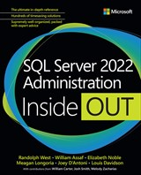
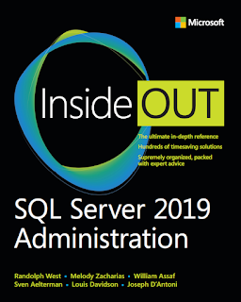
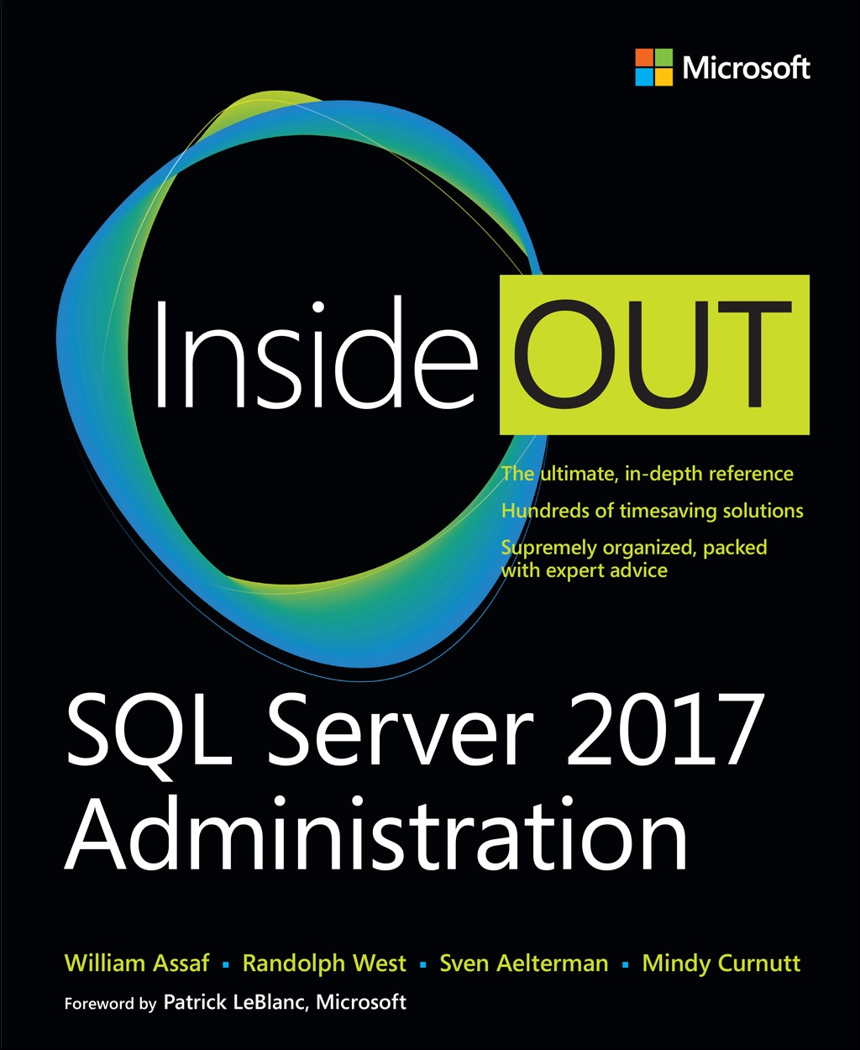
SQL Server 2017 Inside Out
SQL Server Administration Inside Out
by Microsoft Press
2017 published Feb 2018
2019 published March 2020
2022 published May 2023

Slide 48

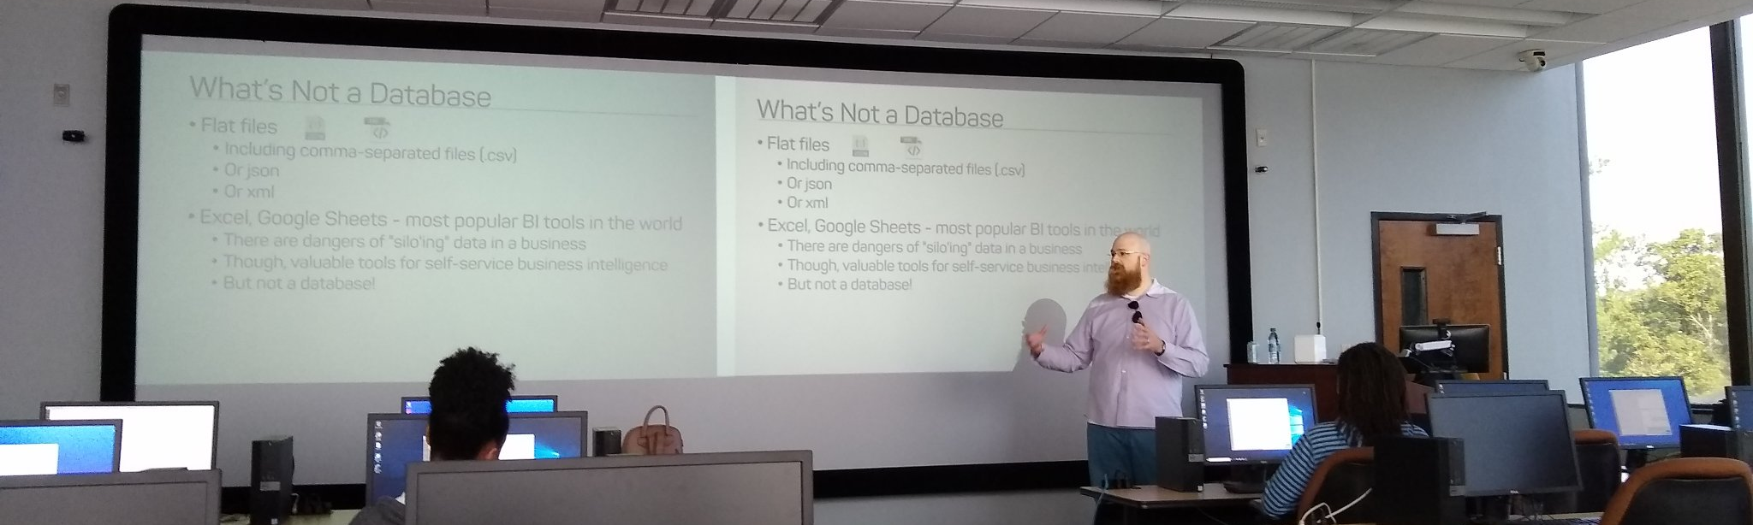
Support your Local STEM Initiatives
I encourage you to find, then donate time and money to local STEM education initiatives where you live. Get involved!
There is almost certainly some nonprofit where you live that needs your enthusiasm and skills to close the achievement gap.
https://www.thewallsproject.org/programs/futures_fund/
Notes:
Here’s a STEM education nonprofit local to me that I volunteer for, please reach out and share your knowledge with the next generation, and especially with folks in your community that are needing to find new careers during the pandemic.

Slide 49


William Assaf
Senior Content Dev, Microsoft Database Docs, Azure SQL DB lead
DBA Consultant, Manager
MS Cert exam SME
Former MSFT MVP, Data Platform
Co-author, Microsoft Press SQL Server Administration Inside Out 2017, 2019, 2022.
Senior Content Developer, Microsoft
SQLTact.com
linkedin.com/in/williamdassaf
Notes:
This presentation is available for download at my blog SQLTact.com.
I just posted a two-part blog series written with a colleague of mine, a doctor in computer science, about test taking, certification exams, and more on my blog at SQLTact.com, check that out next and best of luck on your next exams.

